Slide 1
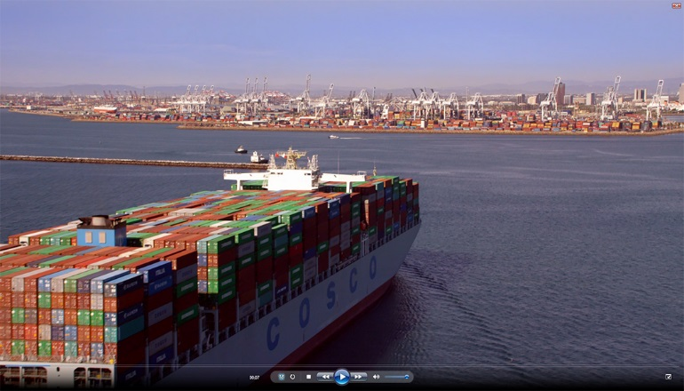
Port of Long Beach
Aerial Video for 2015 State of the Port Event
Videos

